Slide 1
Introduction to D3 SI649/EECS548
September 26/27, 2016
Based in part on:
http://www.jeromecukier.net/blog/2012/10/15/d3-tutorial-at-visweek-2012/ and
http://alignedleft.com/tutorials/d3/

Slide 2
The Extremes
Expressiveness
Google Charts
OpenGL
Excel
Tableau
Processing
Many Eyes
Protovis
GGPlot
Efficiency

Slide 3
D3
Javascript-driven
Successor to Protovis
Open source: http://d3js.org
Note we’ll stick to v3 for the labs (v4 is out)
Interactive Web pages
D3 transforms HTML data
Generates other HTML (uses CSS, SVG, etc.)

Slide 4
HTML – a reminder
Hierarchy of elements
Containers
The ones you need: BODY, DIV, A, P, H1, SPAN
Lists: UL → LI
Forms
<div>
<p>p inside a div</p>
</div>

Slide 5
A few other things
attribute
^{<img src="image.png"/>}
style
<div style="background:black;">
^{some text}
^{</div>}
^{<form>}
<input type="checkbox" checked>
^{Check me out}
^{</form>}
Raw property

Slide 6
D3
Lets you easily create, select, and modify HTML & SVG objects
Quick example (the long way)
body = d3.select("body")
para = body.append("p")
para = para.text("alice")
para = para.style("color","red")
Notice: all commands modify the object in some way and return something (either a new “child” or the same object!)

Slide 7
D3
Lets you easily create, select, and modify HTML & SVG objects
Quick example
body = d3.select("body")
para = body.append("p")
para = para.text("alice")
para = para.style("color","red")
Short version:
para = d3.select("body").append("p").text("alice").style("color","red")

Slide 8
D3
Lets you easily create, select, and modify HTML & SVG objects
Quick example
body = d3.select("body")
para = body.append("p")
para = para.text("alice")
para = para.style("color","red")
(Slightly less) short (but more readable) version:
body = d3.select("body");
para = body.append("p").text("alice").style("color","red");

Slide 9
Things D3 makes easy #1 – Loops

Slide 10
Ok, let’s play with some data
var dataset = [ 5, 10, 15, 20, 25 ];
d3.select("body").selectAll(“p")
.data(dataset)
.enter()
.append("p")
.text("New Paragraph!");

Slide 11
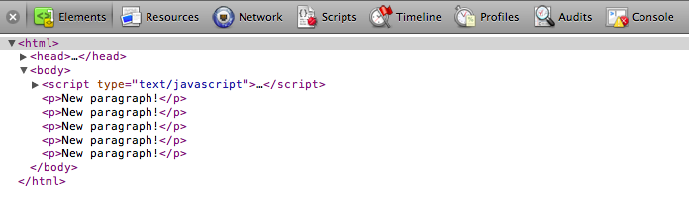
Ok, let’s play with some data
var dataset = [ 5, 10, 15, 20, 25 ];

Slide 12
Things D3 makes easy #2 – Control of display features

Slide 13
Ok, let’s play with some data
var dataset = [ 5, 10, 15, 20, 25 ];
d3.select("body").selectAll("p")
.data(dataset)
.enter()
.append("p")
.text(function(d) { return d; });

Slide 14
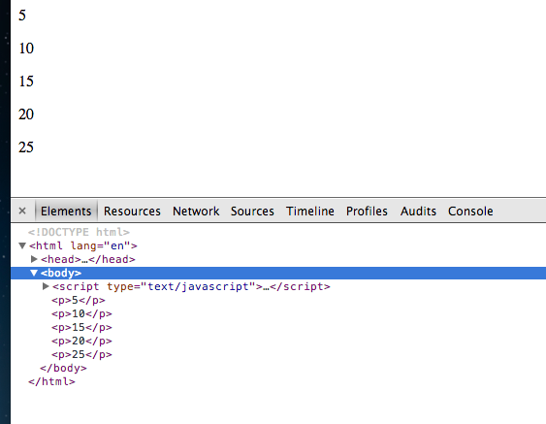
Ok, let’s play with some data
var dataset = [ 5, 10, 15, 20, 25 ];

Slide 15
A note about functions
Functions can have 1 or 2 arguments
One argument version (only the value):
.text(function(d) { return d; });
Two argument version (index & value):
.text(function(d,i) { return i + " " + d; });

Slide 16
Ok, let’s play with some data
var dataset = [ 5, 10, 15, 20, 25 ];
d3.select("body").selectAll("p")
.data(dataset)
.enter()
.append("p")
.text(function(d,i) {
return "element " + i +
" in the dataset is: " + d;
});

Slide 17
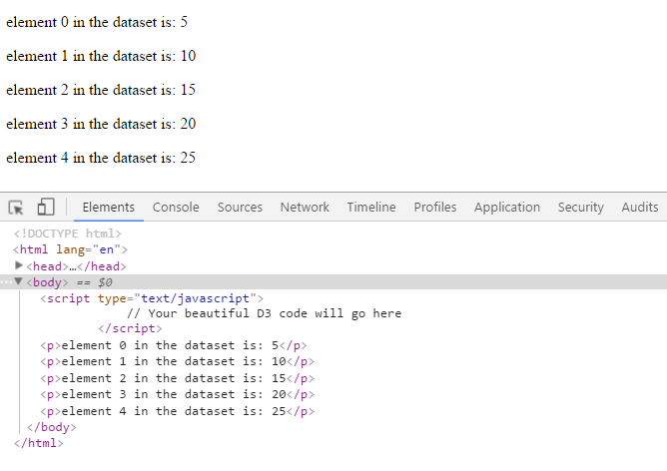
Ok, let’s play with some data
var dataset = [ 5, 10, 15, 20, 25 ];

Slide 18
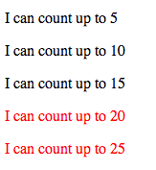
var dataset = [ 5, 10, 15, 20, 25 ];
d3.select("body").selectAll("p")
.data(dataset)
.enter()
.append("p”)
.text(function(d) {
return "I can count up to " + d;
})
.style("color", function(d) {
if (d > 15) {
return "red";
} else {
return "black";
}
});

Slide 19
Things D3 makes easy #3 – Drawing stuff

Slide 20
Drawing stuff - SVG
<svg width=100 height=100>
<rect x=10 y=10 width=50
height=50 style="fill:black;">
</rect>
</svg>

Slide 21
Drawing stuff - SVG
<g>
^{<rect>, <circle>, <line>}
<path>
^{<text>}

Slide 22
D3 – the dummy template
html
body
^{<!DOCTYPE html>}
^{<html>}
^{<head>}
<meta http-equiv="Content-Type" content="text/html;charset=utf-8">
^{<title>My project</title>}
<script type="text/javascript" src="d3.v3.js">
^{</script>}
^{</head>}
^{<body>}
^{<div id="chart"></div>}
^{<script>}
^{… your stuff here…}
^{</script>}
^{</body>}
^{</html>}
chart

Slide 23
javascript
html
body
var w=960,h=500;
var svg=d3.select("#chart")
.append("svg")
.attr("width",w).attr("height",h);
svg
.append("text") .text("hello world!")
.attr("x",100).attr("y",100);
chart
svg
text

Slide 24


Slide 25
javascript
html
var w=960,h=500;
var svg=d3.select("#chart")
.append("svg")
.attr("width",w).attr("height",h);
svg
.append("text") .text("hello world!")
.attr("x",100).attr("y",100);
svg
.append("rect")
.attr({x:50,y:150,height:100,width:100})
.style("fill", "darkorange");
body
chart
svg
text
rect

Slide 26
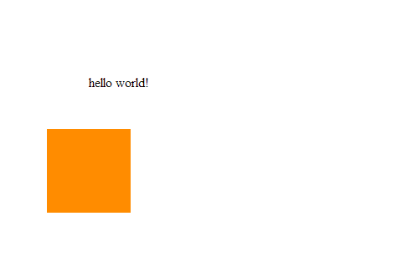

Slide 27
Let’s make a vis…
var dataset = [ 5, 10, 15, 20, 25 ];
html
Grab the “circle” element (there isn’t any)
body
d3.select("svg").selectAll("circle")
.data(dataset)
.enter()
.append("circle")
For every element in the dataset
svg
Create a new placeholder element
Add an element

Slide 28
Binding data
var dataset = [ 5, 10, 15, 20, 25 ];
d3.select("svg").selectAll("circle")
.data(dataset)
.enter()
.append("circle");

Slide 29
A different explanation of binding
var dataset = [ 5, 10, 15, 20, 25 ];
d3.select("svg").selectAll("circle")
.data(dataset)
.enter()
.append("circle");
0 circles

Slide 30
A different explanation of binding
var dataset = [ 5, 10, 15, 20, 25 ];
d3.select("svg").selectAll("circle")
.data(dataset)
.enter()
.append("circle");
5 values
0 circles
5
-
=
20
10
25
Room for 5 circles
15

Slide 31
A different explanation of binding
var dataset = [ 5, 10, 15, 20, 25 ];
d3.select("svg").selectAll("circle")
.data(dataset)
.enter()
.append("circle");
Make me room for:
5
10
15
20
25

Slide 32
A different explanation of binding
var dataset = [ 5, 10, 15, 20, 25 ];
d3.select("svg").selectAll("circle")
.data(dataset)
.enter()
.append("circle");
5
10
15
20
25

Slide 33
If you already have space…
If you already have “space” for your data, you don’t need enter… just selectAll
d3.select("svg").selectAll("circle")
.data(dataset)
.enter()
.append("circle")
.style("fill","blue")
…

Slide 34
Things D3 makes easy #4 – Binding data to objects

Slide 35
Advantage of binding
Each piece of data is connected to a mark on the screen
Data can have multiple variables
Can “bind” data to objects/groups
If you change the data (through interaction, sensor readings change, etc.)
D3 knows the connection between the data and the mark
Will recalculate the visual properties of the mark

Slide 36
More information
More on how selection works:
http://bost.ocks.org/mike/selection/
http://knowledgestockpile.blogspot.com/2012/01/understanding-selectall-data-enter.html

Slide 37
Data based visuals
var dataset = [ 5, 10, 15, 20, 25 ];
d3.select("svg").selectAll("circle")
.data(dataset)
.enter()
.append("circle")
.style("fill","blue")
.attr("cy", 200) // everything should be 200 pixels down
.attr("r", // radius based on value!
function(d) {
return d;
})
.attr("cx", // location based by element #
function (d,i) {
return i * 50;});

Slide 38
Reminder from last week
dataset = [2,3,5,10,5]
foreach (idx in dataset) {
canvas.setFill(“blue”)
cy = 200
radius = data[idx]
cx = idx * 50
canvas.drawCircle(cx,cy,
radius)
}
d3.select("svg")
.selectAll("circle")
.data(dataset)
.enter()
.append("circle")
.style("fill","blue")
.attr("cy”,200)
.attr("r",
function(d) {
return d;
})
.attr("cx",
function (d,i) {
return i * 50;});

Slide 39
Things D3 makes easy #5 (sort of) – Layering to build complex vis

Slide 40
Building more complex vis
Layer using marks
Groups are based on mark type
Takes some practice

Slide 41
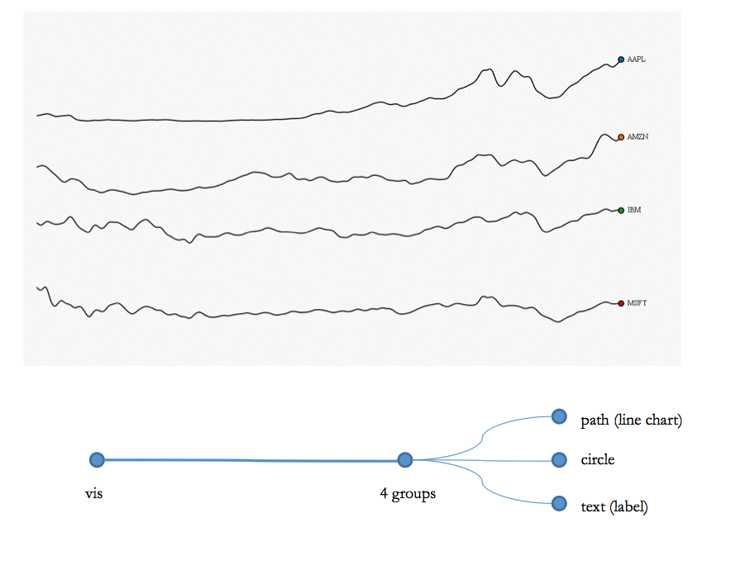

Slide 42
path
circle
text
Not how D3 works!
path
circle
text

Slide 44
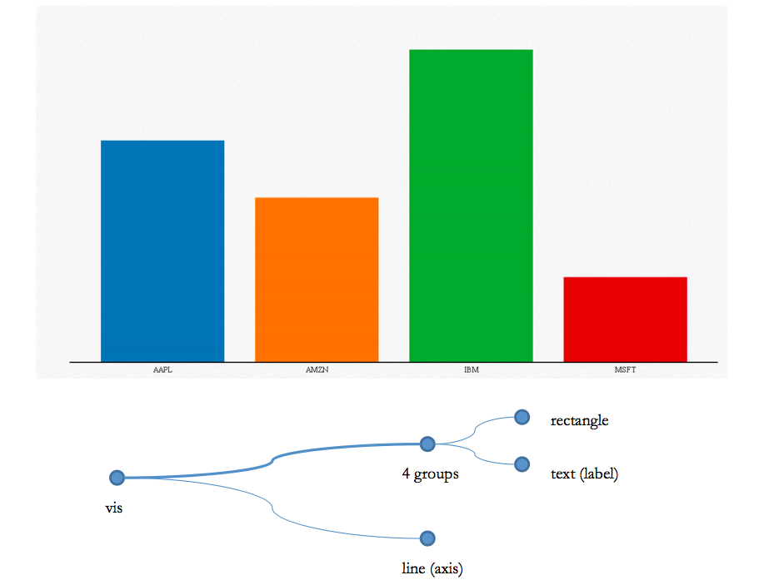

Slide 45
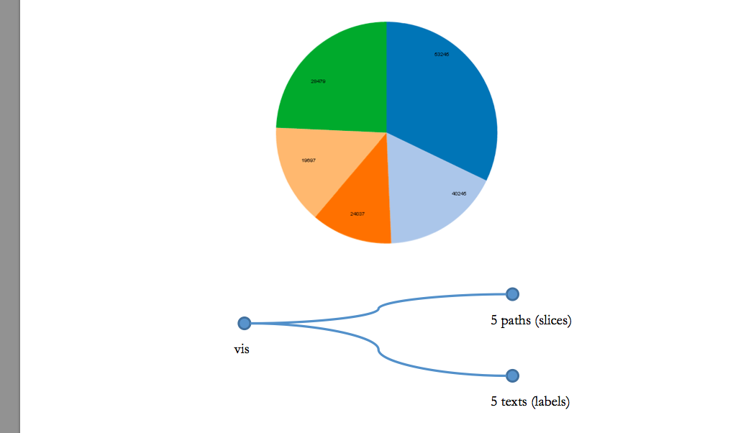

Slide 46
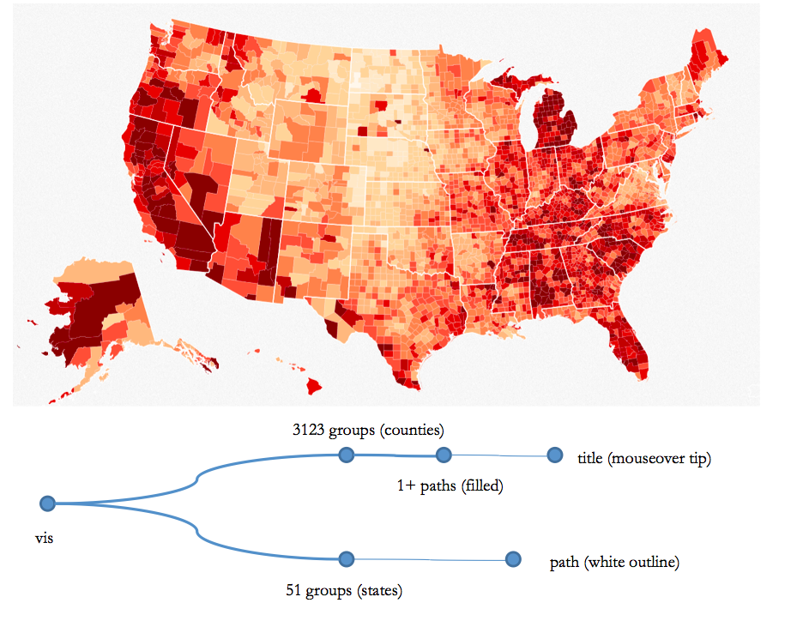

Slide 47
?

